Slide 2
9th Universities, Entrepreneurship and Enterprise Development in Africa
Panel Discussion on Flipped Classroom Approach and Entrepreneurial Skills Development
Consortium of Virtual Exchange Team

Slide 3
Agenda
What is flipped Classroom?
Traditional Classroom methods
Flipped Classroom methods (FCM)
Flipped Classroom and Skills Development
Flipped Classroom and 21st Century Competencies
Developing Entrepreneurial Skills through FCM
Flipping your Classroom
Flipped Classroom Process
The Building Bridges Across Continents Project
2

Slide 4
What is Flipped Classroom?
The THINK-PAIR-SHARE Exercise
Take a moment and reflect on one of your courses/classes:
What does it look like?
What do you do in the classroom?
What do you do outside of your classroom time?
What do your students do in the classroom?
What do your students do outside of the classroom time?
What is the best use of your FTF time with your students?
3

Slide 5
What is Flipped Classroom?
Please Describe this image?
4

Slide 6
What is Flipped Classroom?
A flip lesson inverts the traditional classroom by delivering instruction online outside of class and moving homework and application activities into the classroom.
It is a “pedagogical approach in which direct instruction moves from the group learning space to the individual learning space, and the resulting group space is transformed into a dynamic, interactive learning environment where the educator guides students as they apply concepts and engage creatively in the subject matter” (The Flipped Learning Network, 2014)
5

Slide 7
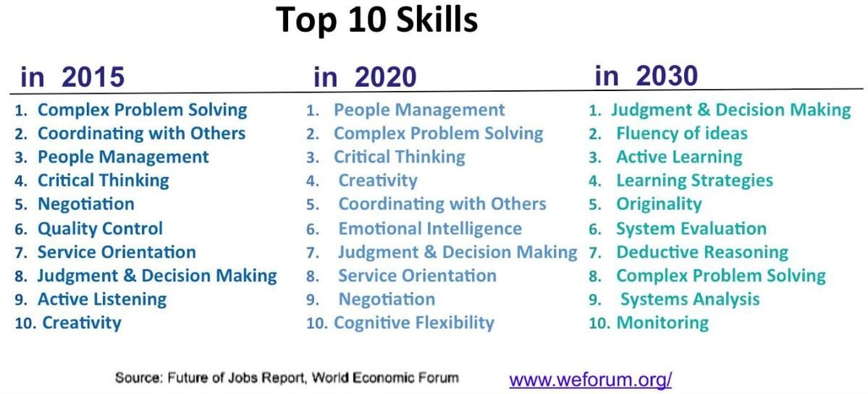
Flipped Classroom and Future Skills
6

Slide 8
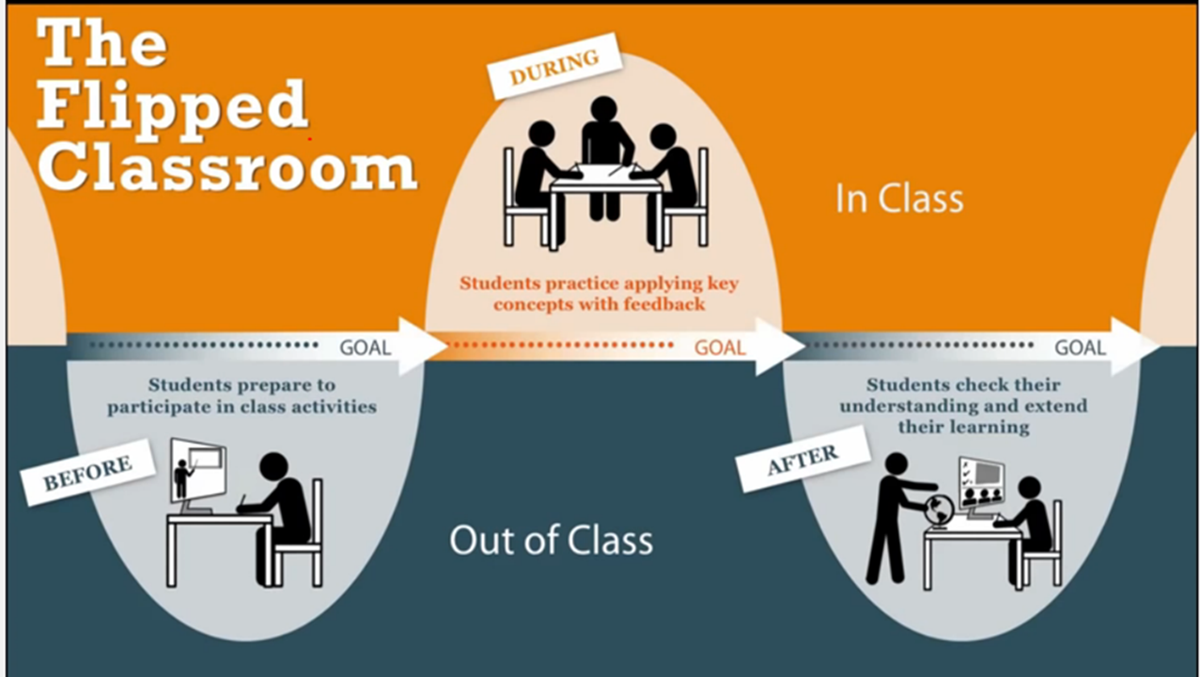
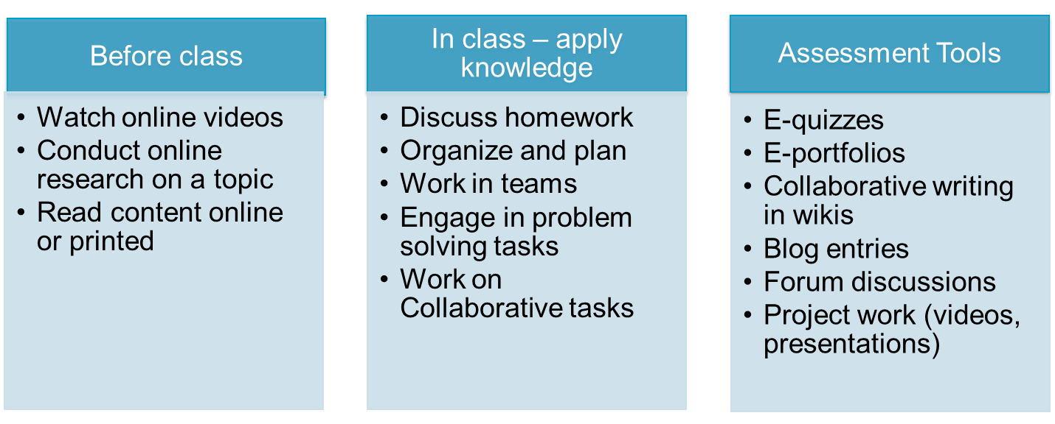
Flipping your Classroom
7

Slide 9
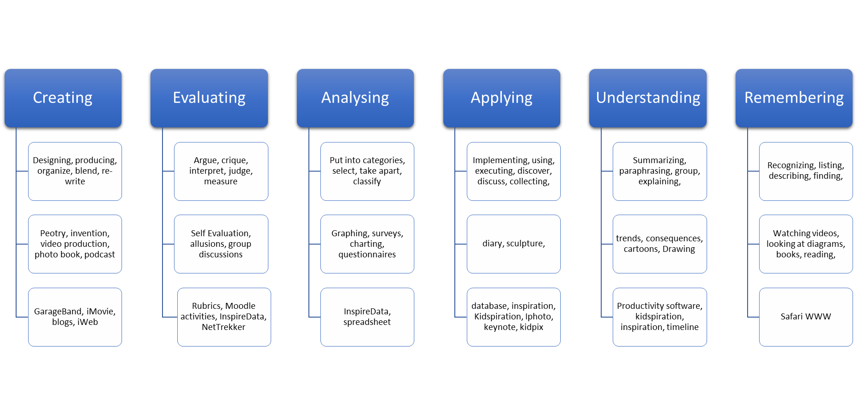
Why do you have to Flip your Classroom?
8

Slide 10
Guide to Flipping your class
Plan
Figure out which lesson in particular you want to flip
Record
Instead of teaching this lesson in-person, make a video. A screencast works
Share
Send the video to your students. Make it engaging and clear.
Change
Now that your students have viewed your lesson, they’re prepared to actually go more in-depth than ever before.
Group and Regroup
An effective way to discuss the topic is to separate into groups where students are given a task to perform
Review, Revise, Repeat

Slide 11
Modes of Learning
Active learning: Allow students to apply concepts in class where they can ask peers or instructors for feedback and clarification.
Peer instruction: Students can teach each other by explaining concepts or working on small problems.
Collaborative learning: CL activities could increase student engagement, enhance student understanding, and promote collective intelligence.
Problem-based learning. Class time can be spent working on problems that can last for the duration of a semester.
Discussions or debate. Give students the opportunity to articulate their thoughts on the spot and to develop their arguments in support of their opinions or claims.

Slide 12
Steps in Flipping the Class
Step 1: Define content scope, learning objectives, & instructional strategies
Defining scope is important so that students will not have difficulty building a mental model and connecting content.
Define the learning objectives and outcomes that align with the activities students will do before, during, and after the class.
Describe the task that will demonstrate that the learning objective has been met.
Choose the evidence-based instructional approach will fit the main learning activity (i.e.: peer-instruction, team-based learning, case-based learning, process-oriented guided inquiry learning).
Set expectations by preparing an explanation of how the new instructional material fits into the overall existing course structure and explains its relevance to real world applications.
Source: New York University

Slide 13
Steps in Flipping the Class
Step 2: Students gain familiarity with new material before class
Plan and prepare the new instructional materials that students will engage with prior to class.
Step 3: Activities that motivate students to prepare before class
What kinds of activities will motivate students and prepare them for class?
Ask students to:
respond to open-ended questions online about the instructional material before class
prepare questions about the instructional materials
prepare a presentation about the topic
attempt to solve some problems
research examples to bring to class that illustrate a principle
Source: New York University

Slide 14
Steps in Flipping the Class
Step 4: In-class activities that provide students opportunities to deepen understanding
What kind of in-class activities will focus students on attaining higher-level cognitive abilities?
Step 5: Post-class activities that extend student learning
How will students continue the learning experience from the in-class activity to outside of class?
Step 6: Ongoing evaluation and assessment
Assessment (summative & formative assessment)
Plan for ongoing formative and summative ways to assess student understanding and mastery.
Source: New York University

Slide 15
Thank You
14

